Slide 1

Junior Uniform
Senior Uniform
Sports Uniform
Other

Slide 2
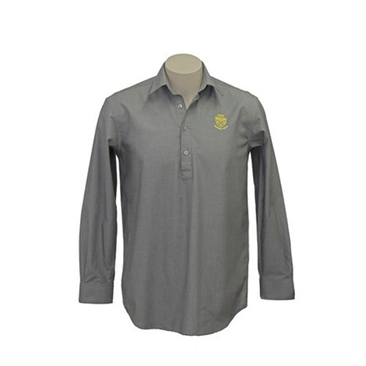
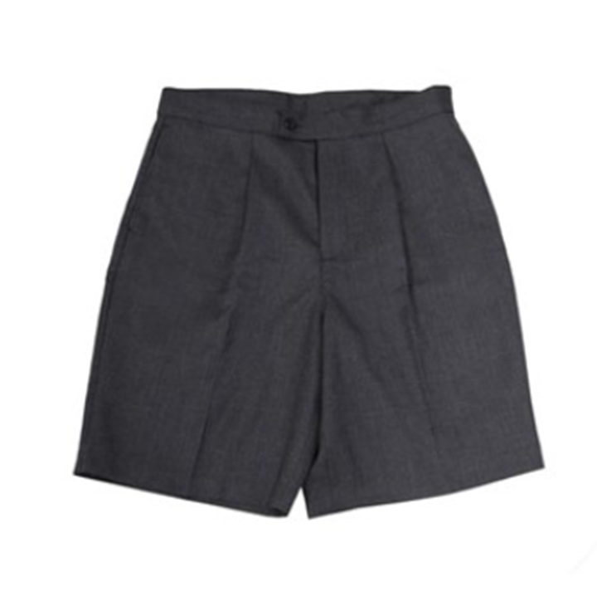
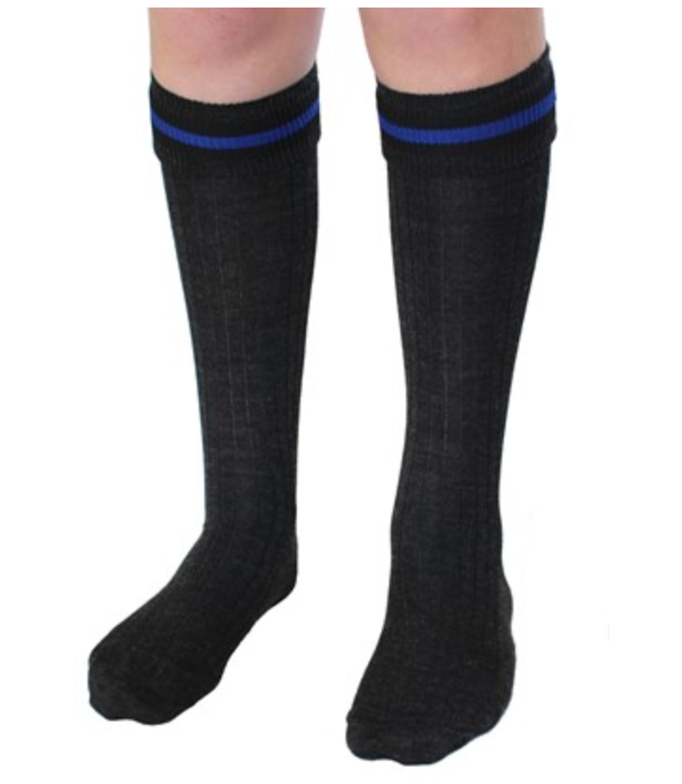
Junior Uniform
Senior Uniform
Sports Uniform
Other
Grey shirt
Junior shorts
Junior socks

Slide 3
Junior Uniform
Senior Uniform
Sports Uniform
Other
Senior school uniform

Slide 4
Junior Uniform
Senior Uniform
Sports Uniform
Other
CBHS pe uniforms and sports uniforms

Slide 5
Junior Uniform
Senior Uniform
Sports Uniform
Other
Other items such a hoodies and beanie

Slide 6
Junior Uniform
Senior Uniform
Sports Uniform
Other
Junior grey shirt
The junior shirt is worn all year round by year 9 and 10
Size 8

Slide 7

Junior Uniform
Senior Uniform
Sports Uniform
Other
Information about product similar to other page

Slide 8
Junior Uniform
Senior Uniform
Sports Uniform
Other
Junior grey shirt
The junior shirt is worn all year round by year 9 and 10
Size 8
Size 10
Size 12
Size 14
Size Small
Size Medium
Size Large
Size XL
Size 2XL
Size 3XL

